Slide 1

Evolutionary Kinship between the soil borne Oomycete
Pp563
Amit Sharma

Slide 2
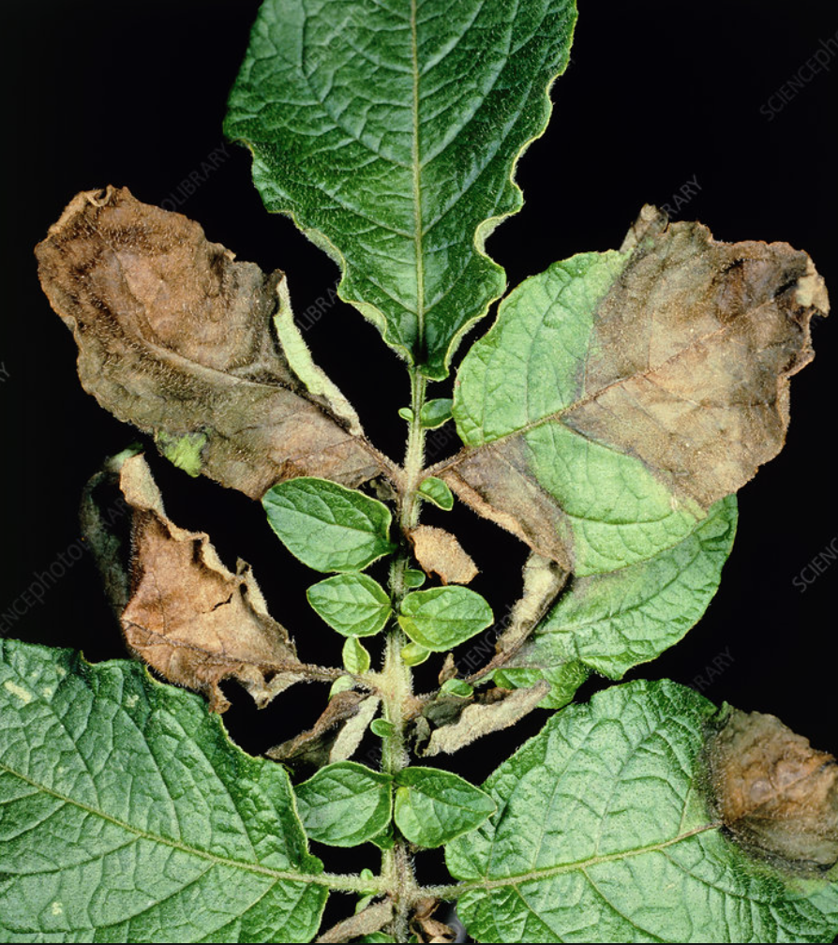
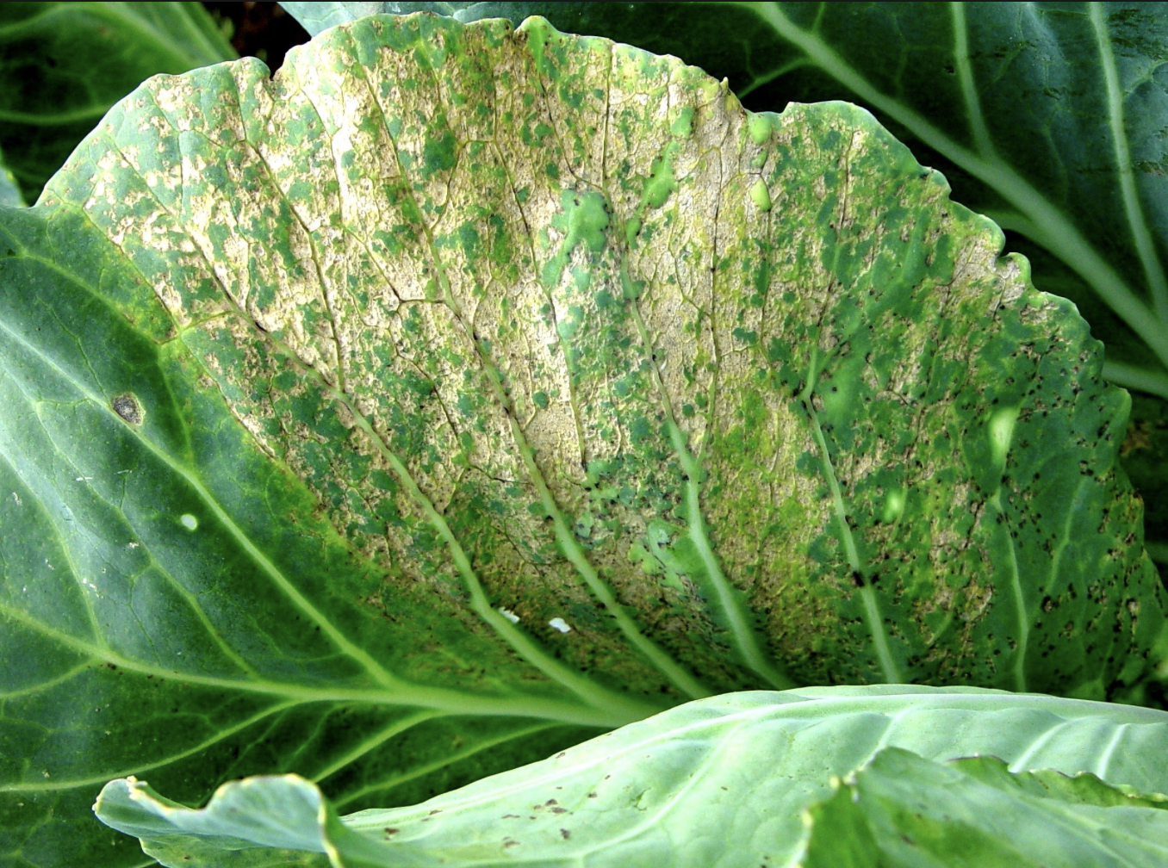
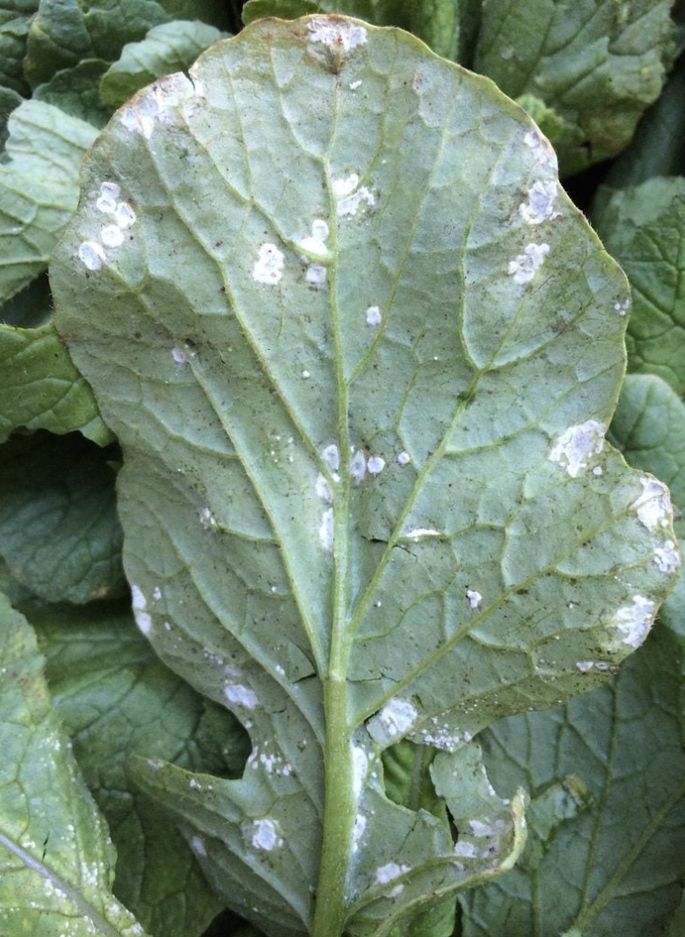
Introduction
Cell wall
chitin
Damp
Sexually-oospore
Asexually-zoospores
Oomycete- Fungus like organism, not true fungi
Have you heard of diseases?
Late blight of potato Downy mildew White rust

Slide 3
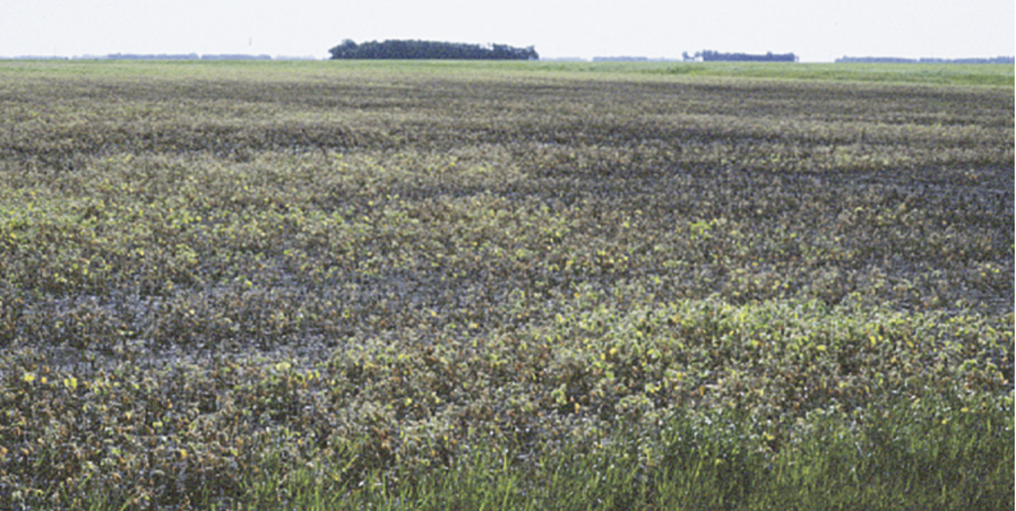
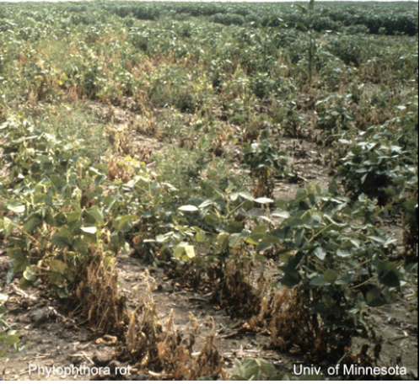
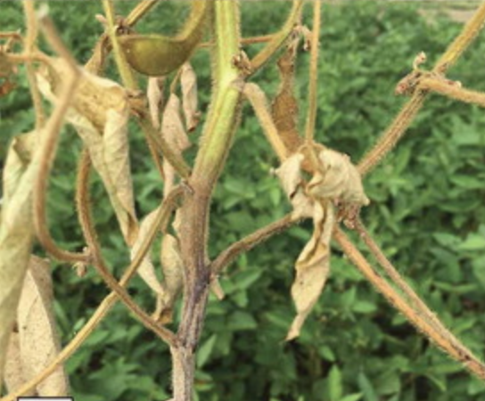
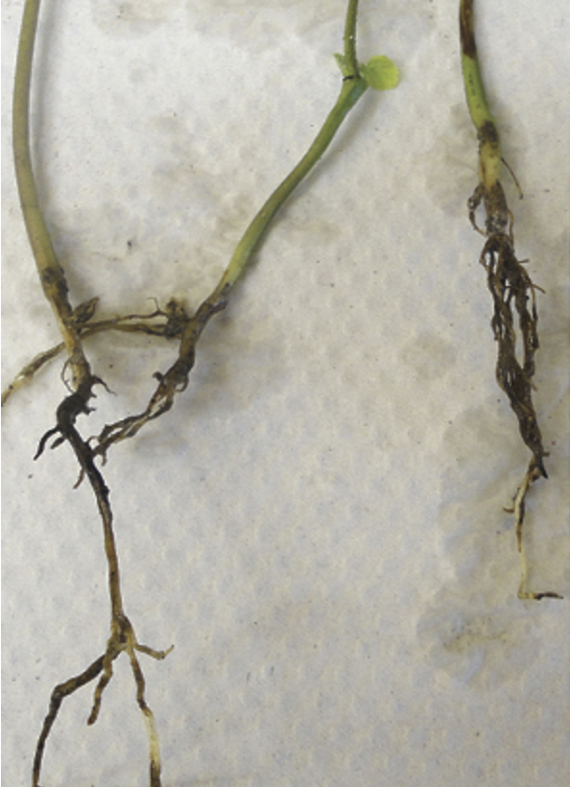
Introduction
Project focus
Pythium
Phytophthora
Damping off
NDSU,MSU

Slide 4
Project goal
To map the evolutionary tree and assess the genetic relatedness of the Phytophthora and Pythium genera

Slide 5
Methods (Data)
Samples of soils from Wisconsin
Soil was baited to get the pathogen (pythium/phytophthora)
Pathogen cultured in PDB
DNA was extracted from the pathogen
ITS6 forward and ITS4 reverse primers were used to amplify DNA
DNA is sequenced and then computationally assembled using the Tadpole algorithm to create a single, high-confidence sequence

Slide 6
Input data
Region covered- 1 (ITS)
No. of Sequences used- 25

Slide 7
Multiple Sequence Alignment
MSA is a crucial step since phylogenetic inference methods assume that residue homology relationships are correctly reflected by the input sequences
MUSCLE
MUSCLE's algorithm, including rapid distance estimation via kmer counting, progressive alignment using a new profile function called the log-expectation score, and refinement using tree-dependent restricted partitioning.
MUSCLE demonstrates high accuracy in alignment, ranking highest or joint highest in accuracy across several test sets when compared to other methods like T-Coffee, MAFFT, and CLUSTALW.
MUSCLE is fast, especially with large numbers of sequences.
It undergoes a draft progressive stage for speed, an improved progressive stage using more accurate distance measures for higher accuracy, and a refinement stage for optimizing alignments.
MUSCLE may struggle with accurate alignment of highly divergent sequences or specialized data types like transmembrane regions and can be resource-intensive when dealing with extremely large datasets

Slide 8
Choosing criteria to make the tree
Distance based method- NJ algorithm
Maximum likelihood- IQtree

Slide 9
NJ Tree
Distance based method- The primary goal is to group sequences that are closely related (i.e., have smaller distances between them) and place those with greater distances further apart on the tree.
NJ tree-
This is a bottom-up clustering method that seeks the tree with the shortest total branch length.
It starts by finding the pair of taxa that minimize the total branch length when joined, creates a node representing their last common ancestor, and then reduces the matrix by replacing the two taxa with the new node.
This process is repeated iteratively until only two taxa remain, which are then joined.
Distance methods reduce the phylogenetic information to one value per pair of sequences, so many times regarded as inferior compared to character-based methods
Less flexible than likelihood methods and noisy distances can affect the estimate tree quality

Slide 10
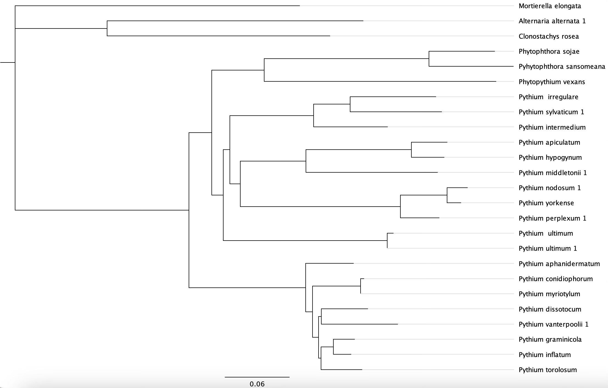
NJ Tree

Slide 11
IQ Tree
Likelihood based method- the combination of hill-climbing and a stochastic perturbation method implemented in IQ-TREE that allows it to find higher likelihood trees efficiently.
IQ-tree finds more higher-likelihood trees than raxml or phyml from same DNA alignments
Flexibility in their user settings (customization)
Effective tree search algorithm
Employs small population of candidate trees
Wide collection of models (non-reversible and reversible)
Requires longer CPU times than raxml for 75% of DNA alignments tested

Slide 12
IQ Tree

Slide 13
Concluding remark

Slide 14
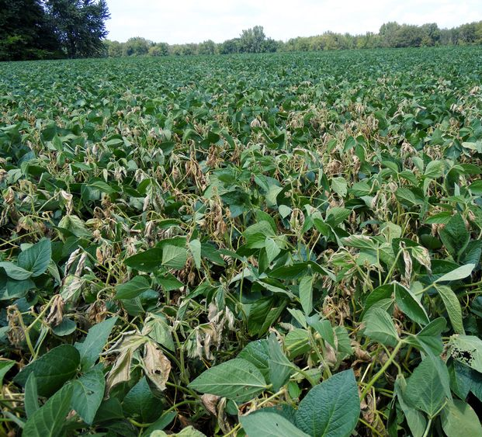
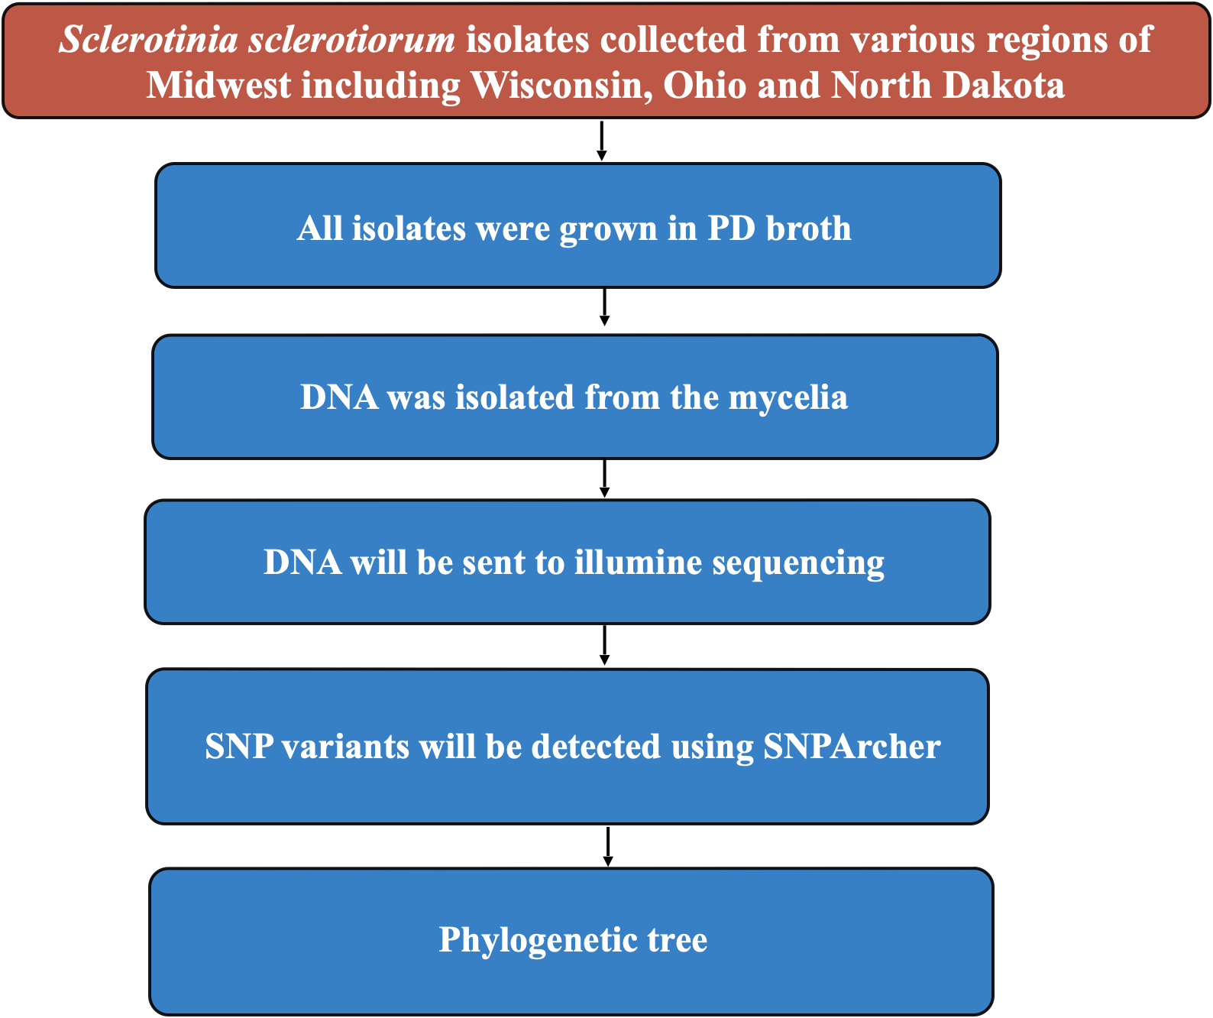
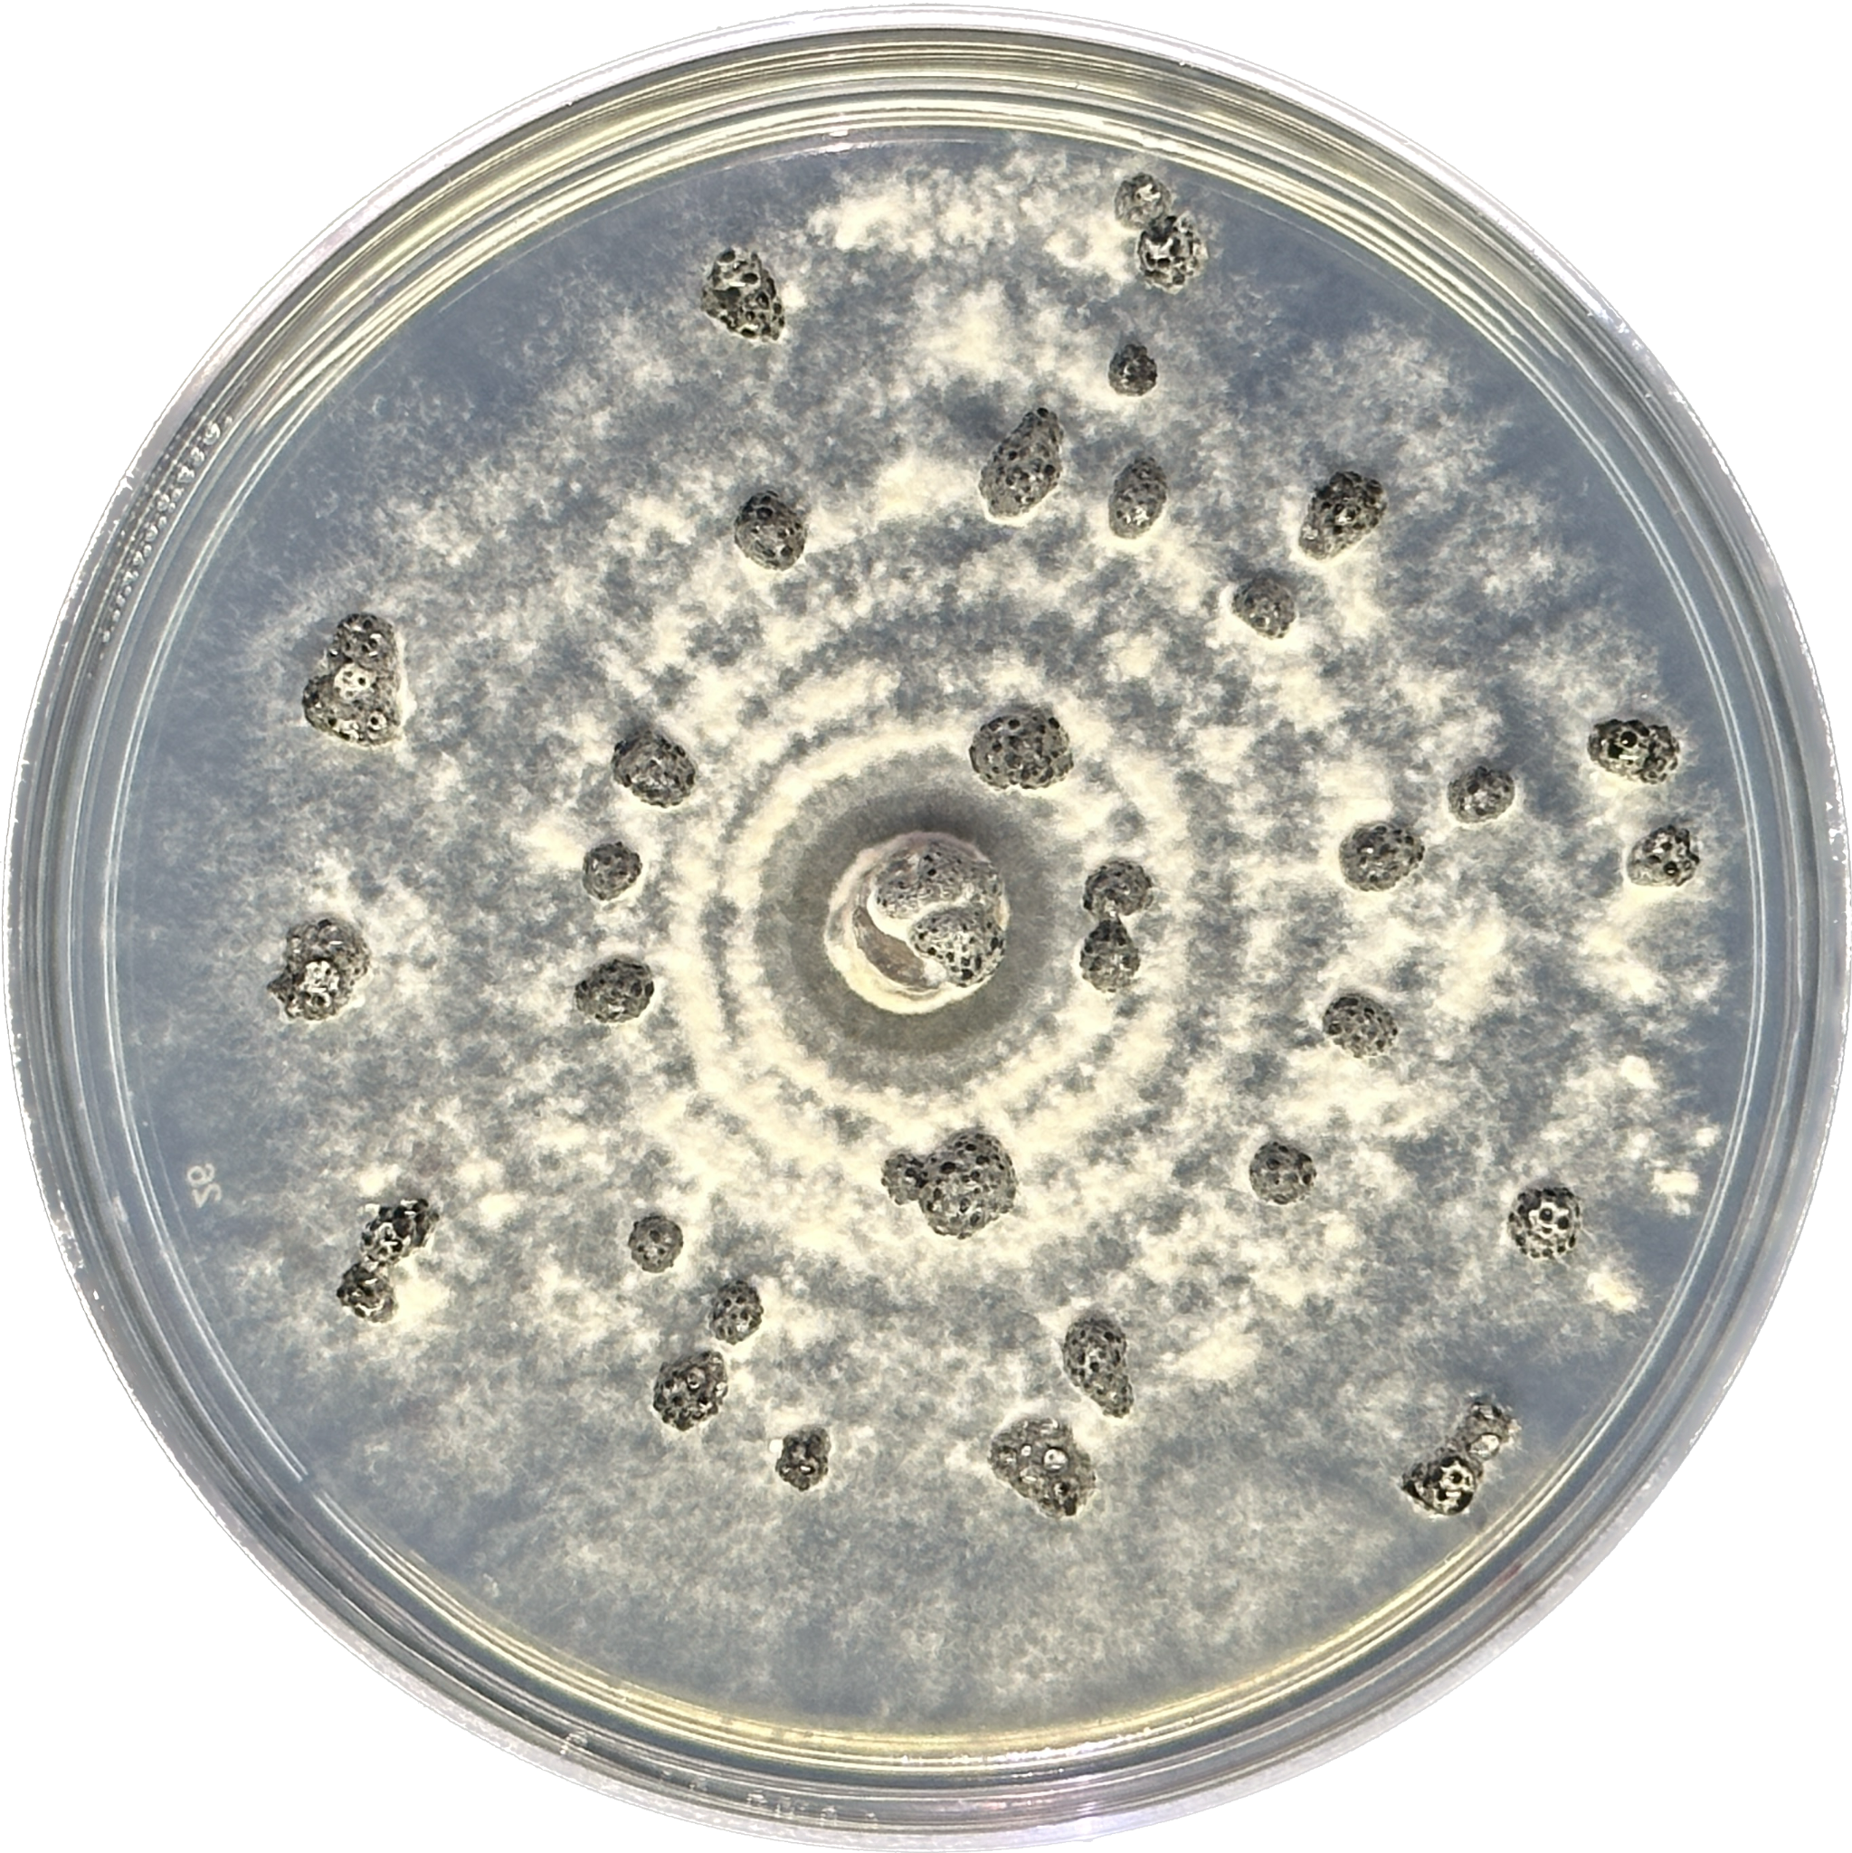
Another project
White mold in Soybean
Causal organism- Sclerotinia sclerotiorum
Molecular variability
SNP variants in the whole genome

Slide 15
Molecular variability
Isolated DNA
Illumina short read sequencing
Quality Control
Sort BAM file by SAM tools and calculate the coverage
Aligned SAM file
Aligned BAM file
VCF file (SAM tools and BCF tools)
Reference genome
Indexing the reference genome using BWA index
BWA mem

Slide 16
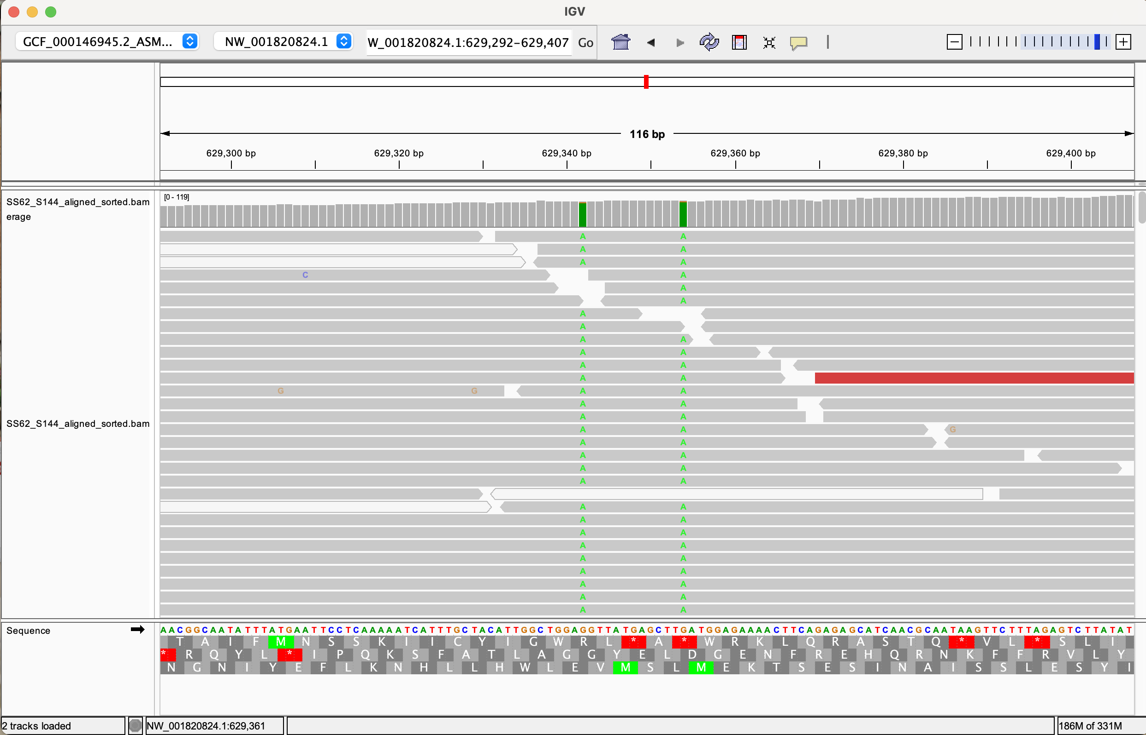
Molecular variability
Integrative genome viewer
16

Slide 17
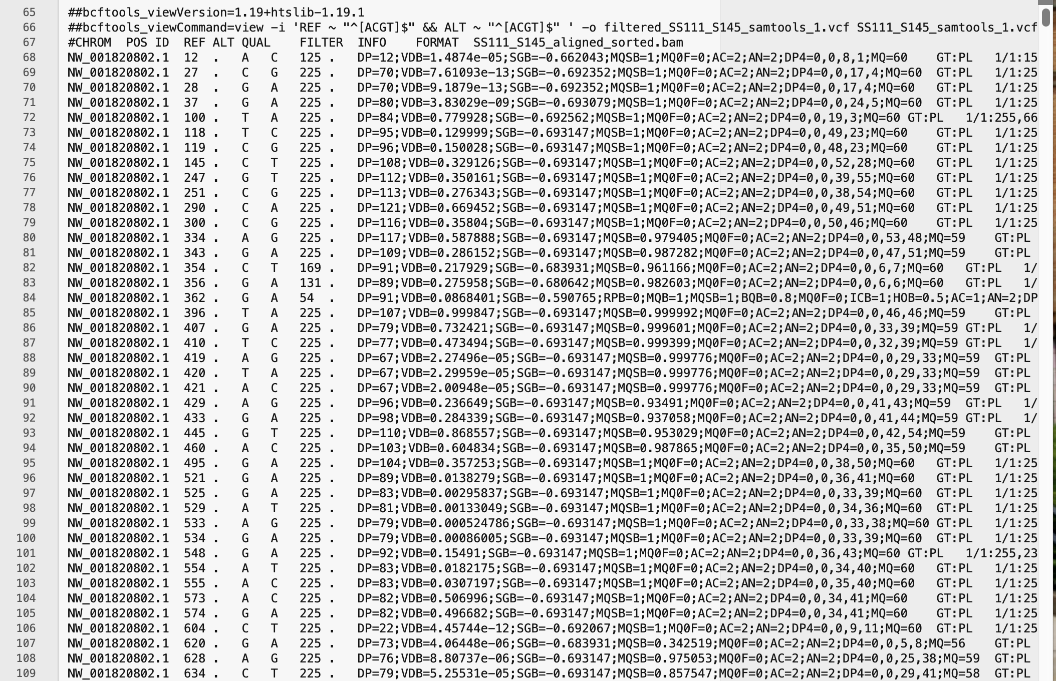
Filtered VCF file
Next steps
Send more samples for sequencing (100)
snpArcher
Making phylogentic tree from Variants
Median coverage
SS3-103
SS62-142
SS111-113
Median coverage per contig >100, very good coverage
17

Slide 18
Thank you!

